Slide 1
The MIT Press Fall 2023 Preview
Trade: pages 2-17
Textbooks: pages 18-30

Slide 2
On Disinformation How to Fight for Truth and Protect Democracy By Lee McIntyre
In On Disinformation, Lee McIntyre shows how the war on facts began, and how ordinary citizens can fight back against the scourge of disinformation that is now threatening the very fabric of our society.
Political Science

Slide 3
Evolutionary Intelligence How Technology Will Make Us Smarter By W. Russell Neuman
A surprising vision of how human intelligence will coevolve with digital technology and revolutionize how we think and behave.
Evolutionary Intelligence demonstrates that our future depends on our ability to computationally compensate for the limitations of a human cognitive system that has only recently graduated from hunting and gathering.
Technology

Slide 4
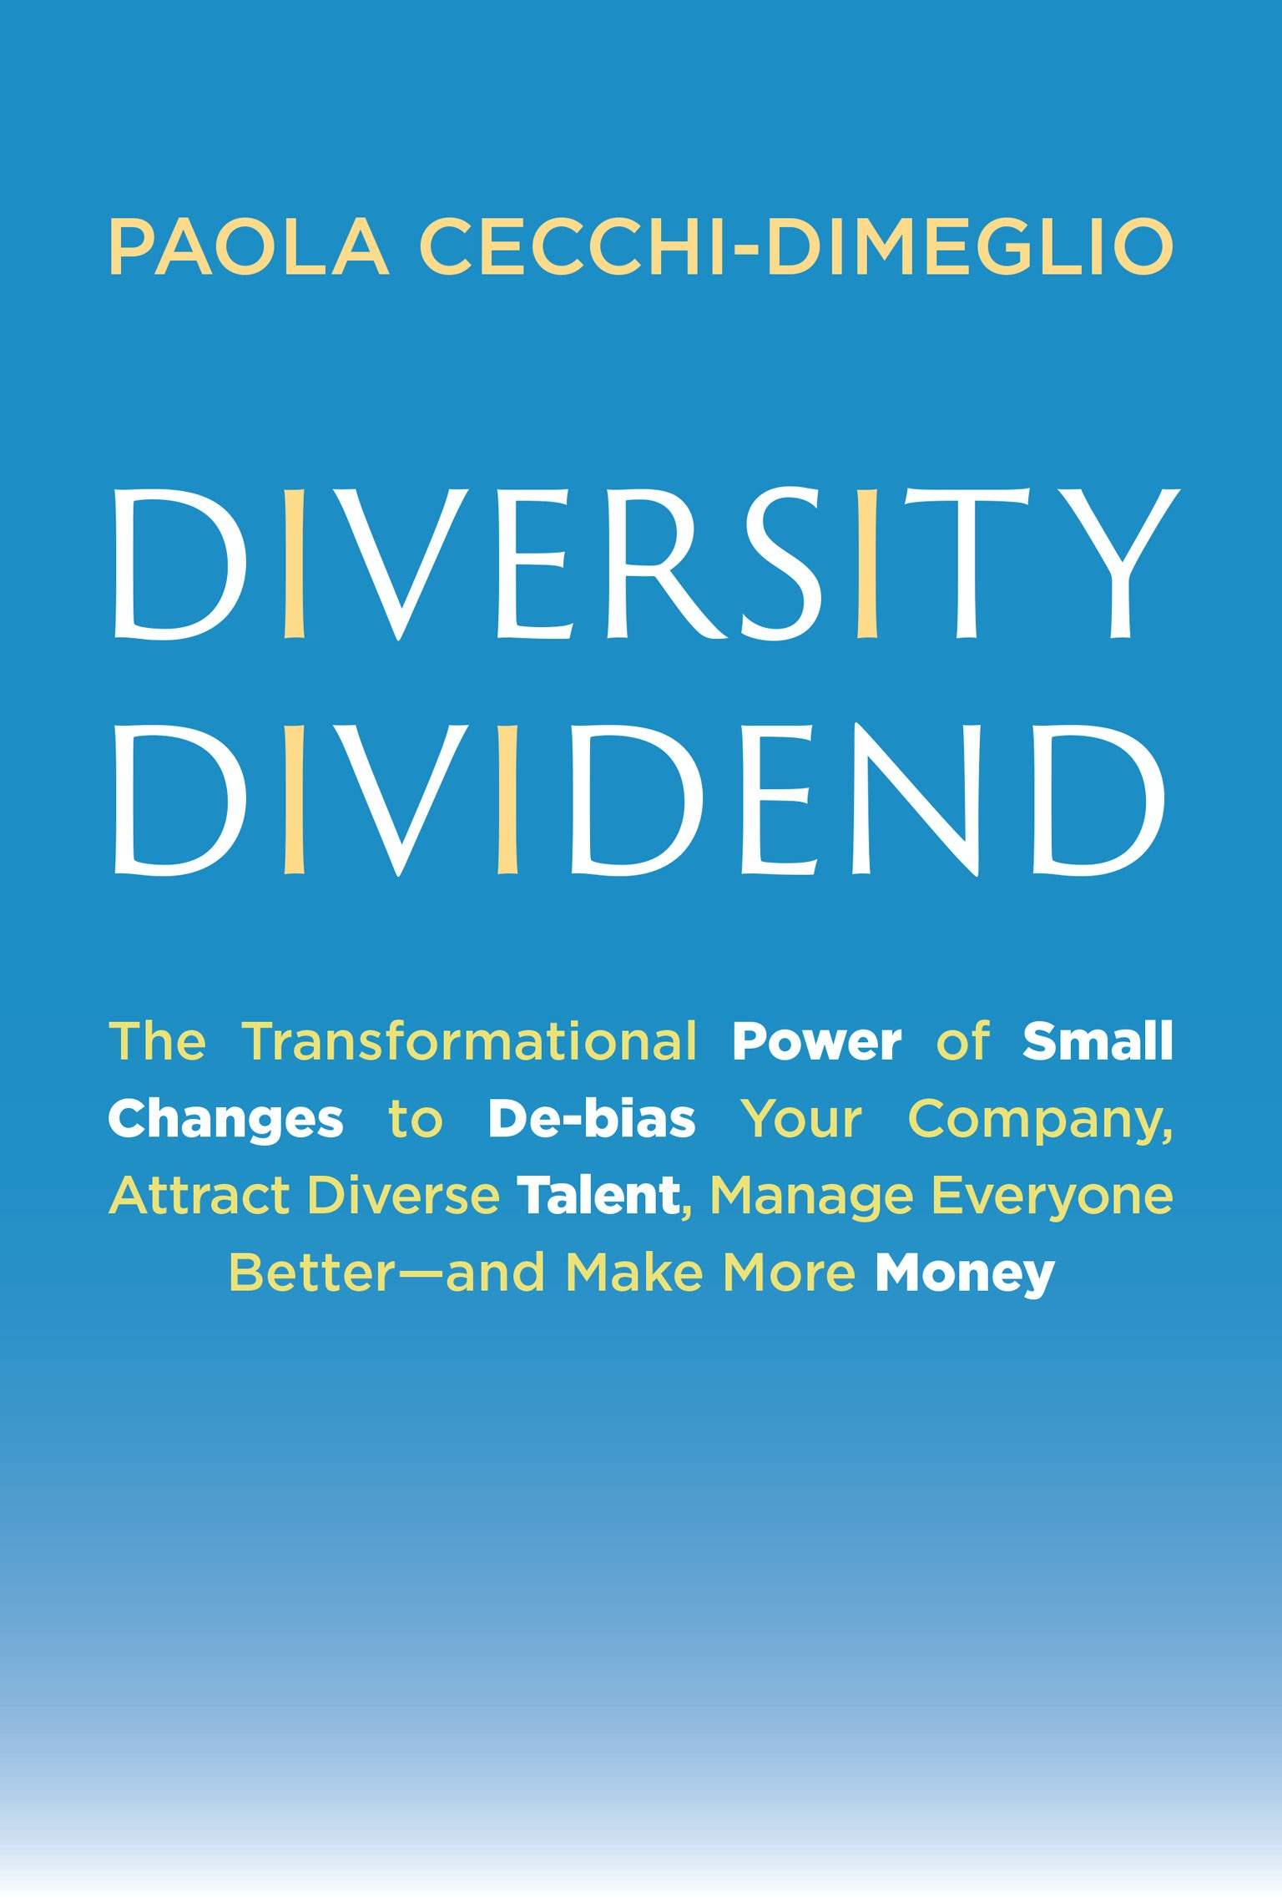
Diversity Dividend By Paola Cecchi-Dimeglio
Paola Cecchi-Dimeglio offers a fresh, detailed look at just how to realize gender and racial equity along the company-employee pathway—from attracting and interviewing applicants to onboarding, promoting, and sustaining hires—and how to remove systemic barriers at the organizational level that prevent women and underrepresented groups from advancing.
Business

Slide 5
Code to Joy Why Everyone Should Learn a Little Programming By Michael L. Littman
In this informative, accessible, and very funny book, Michael L. Littman inspires readers to learn how to tell machines what to do for us.
Rather than give in to the fear that computers will steal our jobs, spy on us, control what we buy and whom we vote for, we can improve our relationship with them just by learning basic programming skills.
Technology

Slide 6
Defending Animals Finding Hope on the Front Lines of Animal Protection By Kendra Coulter
Defending Animals is a gritty and moving portrait of the real work of animal protection that takes place in communities, courtrooms, and boardrooms.
An in-depth look at the urgent struggle to protect animals from harm, cruelty, injustice, extinction, and their greatest threat—us.
Social Science

Slide 7
Our Ancient Lakes A Natural History By Jeffrey McKinnon
The unexpected diversity, beauty, and strangeness of life in ancient lakes—some millions of years old—and the remarkable insights the lakes are yielding about the causes of biodiversity.
Science

Slide 8
Feminist Designer On the Personal and the Political in Design Edited by Alison Place
Feminist Designer brings together a constellation of voices and perspectives to examine the intersection of design and feminist theory.
Contains essays, case studies, and dialogues by 43 contributors from 16 different countries. It engages a wide variety of design disciplines, from graphic design to disability design to algorithmic design, and explores key feminist themes, such as power, knowledge, care, plurality, liberation, and community.
Design

Slide 9
Amanza Lee Meredith Imagines Herself Modern Architecture and the Black American Middle Class By Jacqueline Taylor
The extraordinary life and work of architect Amaza Lee Meredith, and the role modernism and material culture played in the aspiring Black American middle class of the early twentieth century.
Architecture

Slide 10
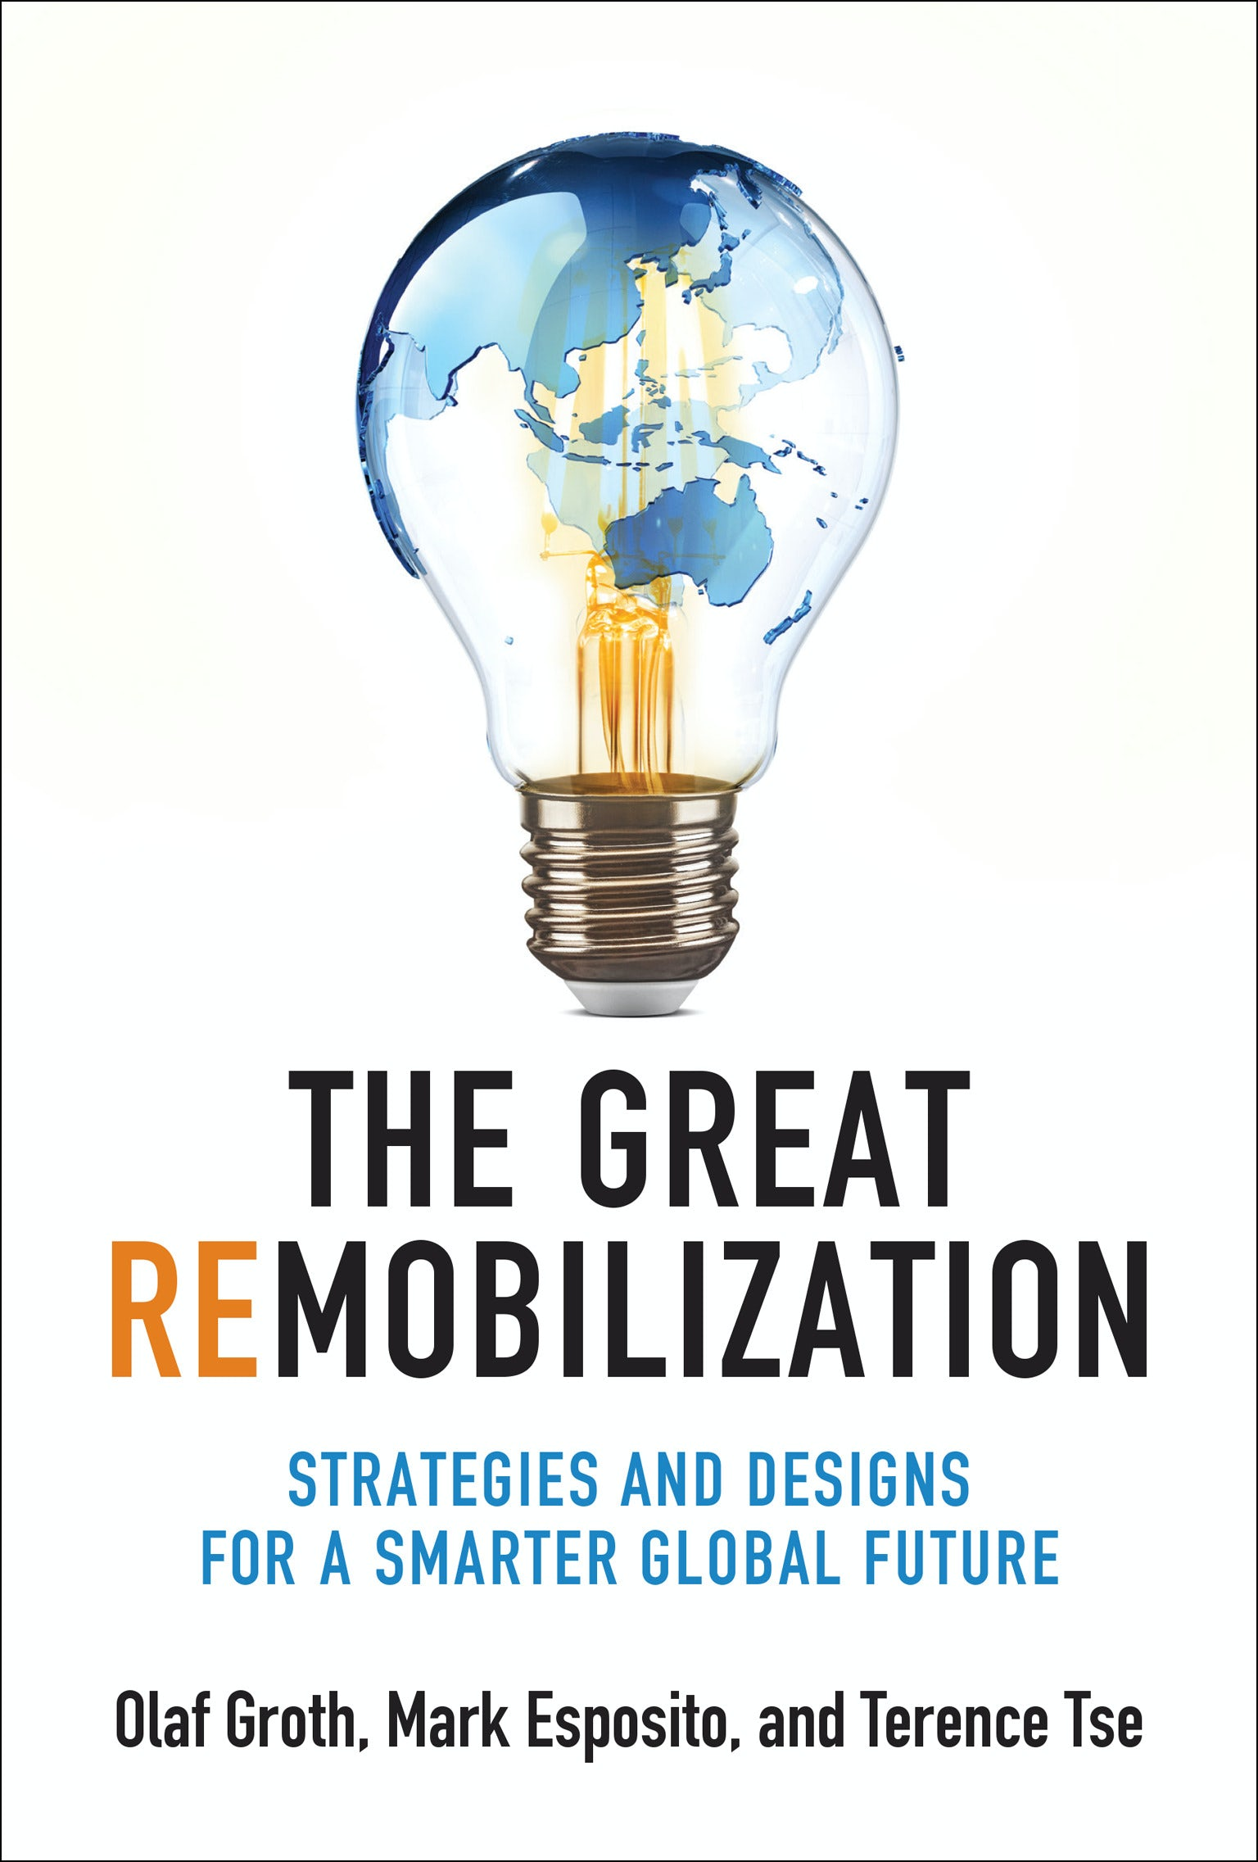
The Great Remobilization Strategies and Designs for a Smarter Global Future By Olaf Groth, Mark Esposito, and Terence Tse
How the turmoil of recent years gives leaders an unprecedented opportunity to redesign global strategies and systems and to remobilize toward a smarter, more resilient, and equitable future.
Business and Economics

Slide 11
Mondrian’s Dress Yves Saint Laurent, Piet Mondrian, and Pop Art By Nancy J. Troy and Ann Marguerite Tartsinis
An extraordinary look at how the style of Piet Mondrian’s abstract paintings was posthumously appropriated by 1960s fashion, Pop art, and consumer culture.
Art

Slide 12
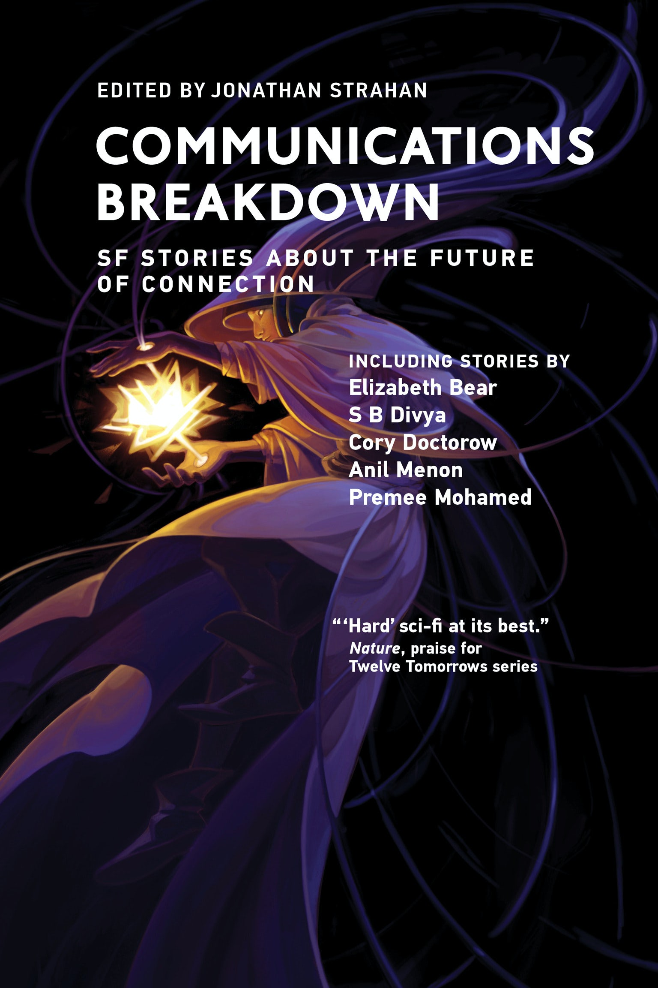
Communications Breakdown SF Stories about the Future of Connection Edited by Jonathan Strahan
An exciting science fiction collection that looks at what future communication might look like and how our shifting relationships with technology could change this most human of capabilities.
Contributors: Elizabeth Bear, S.B. Divya, Cory Doctorow, Chris Gilliard, Lavanya Lakshminarayan, Ken Macleod, Tim Maughan, Ian McDonald, Anil Menon, Premee Mohamed, and Shiv Ramdas. Artwork by Ashley Mackenzie
.
Science Fiction

Slide 13
The Hidden Factor Mark and Gesture in Visual Design By Steven Skaggs
The Hidden Factor is an eye-opening read that brings to the fore the importance—and indeed, the prevalence—of the mark in everything we see.
An exquisitely illustrated introduction to the gestural mark in the designed world, exploring the tension between marks, which are felt, and images and words, which are conceptual.
Design

Slide 14
Inside the Star Factory The Creation of the James Webb Space Telescope By Chris Gunn and Christopher Wanjek
Accompanied by science writer Christopher Wanjek’s overview of the Webb’s history and profiles of the scientists and engineers who built it, this exclusive illustrated guide shows readers the heady world of scientific discovery at the very limits of human knowledge—and the very beginning of space and time.
Technology

Slide 15
Writing for Their Lives America’s Pioneering Female Science Journalists By Marcel Chotkowski LaFollette
A breathtaking history of America’s trail-blazing female science journalists—and the timely lessons they can teach us about equity, access, collaboration, and persistence.
Science

Slide 16
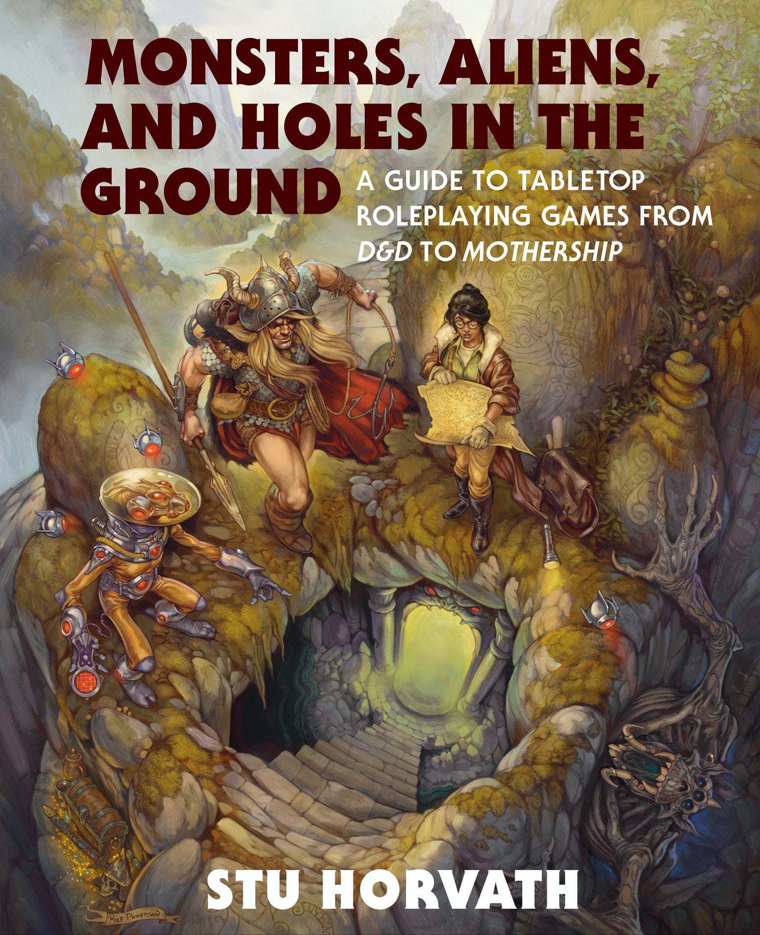
Monsters, Aliens, and Holes in the Ground A Guide to Tabletop Roleplaying Games from D&D to Mothership By Stu Horvath
Monsters, Aliens, and Holes in the Ground features (among other things) bunnies, ghostbusters, soap operas, criminal bears, space monsters, political intrigue, vampires, romance, and, of course, some dungeons and dragons. In a decade-by-decade breakdown, Horvath chronicles how RPGs have evolved in the time between their inception and the present day, offering a deep and gratifying glimpse into a hobby that has changed the way we think about games and play.
Gaming

Slide 17
Data is Everybody’s Business The Fundamentals of Data Monetization By Barbara H. Wixom, Cynthia M. Beath, and Leslie Owens
Offers a clear and engaging way for people across the entire organization to understand data monetization and make it happen.
The authors identify three viable ways to convert data into money—improving work with data, wrapping products with data, and selling information offerings—and explain when to pursue each and how to succeed.
Business

Slide 18
Understanding Deep Learning By Simon J. D. Prince
An authoritative, accessible, and up-to-date treatment of deep learning that strikes a pragmatic middle ground between theory and practice.
Short, focused chapters progress in complexity, easing students into difficult concepts
Minimal mathematical prerequisites, extensive illustrations, and practice problems make challenging material widely accessible
Programming exercises offered in accompanying Python Notebooks

Slide 19
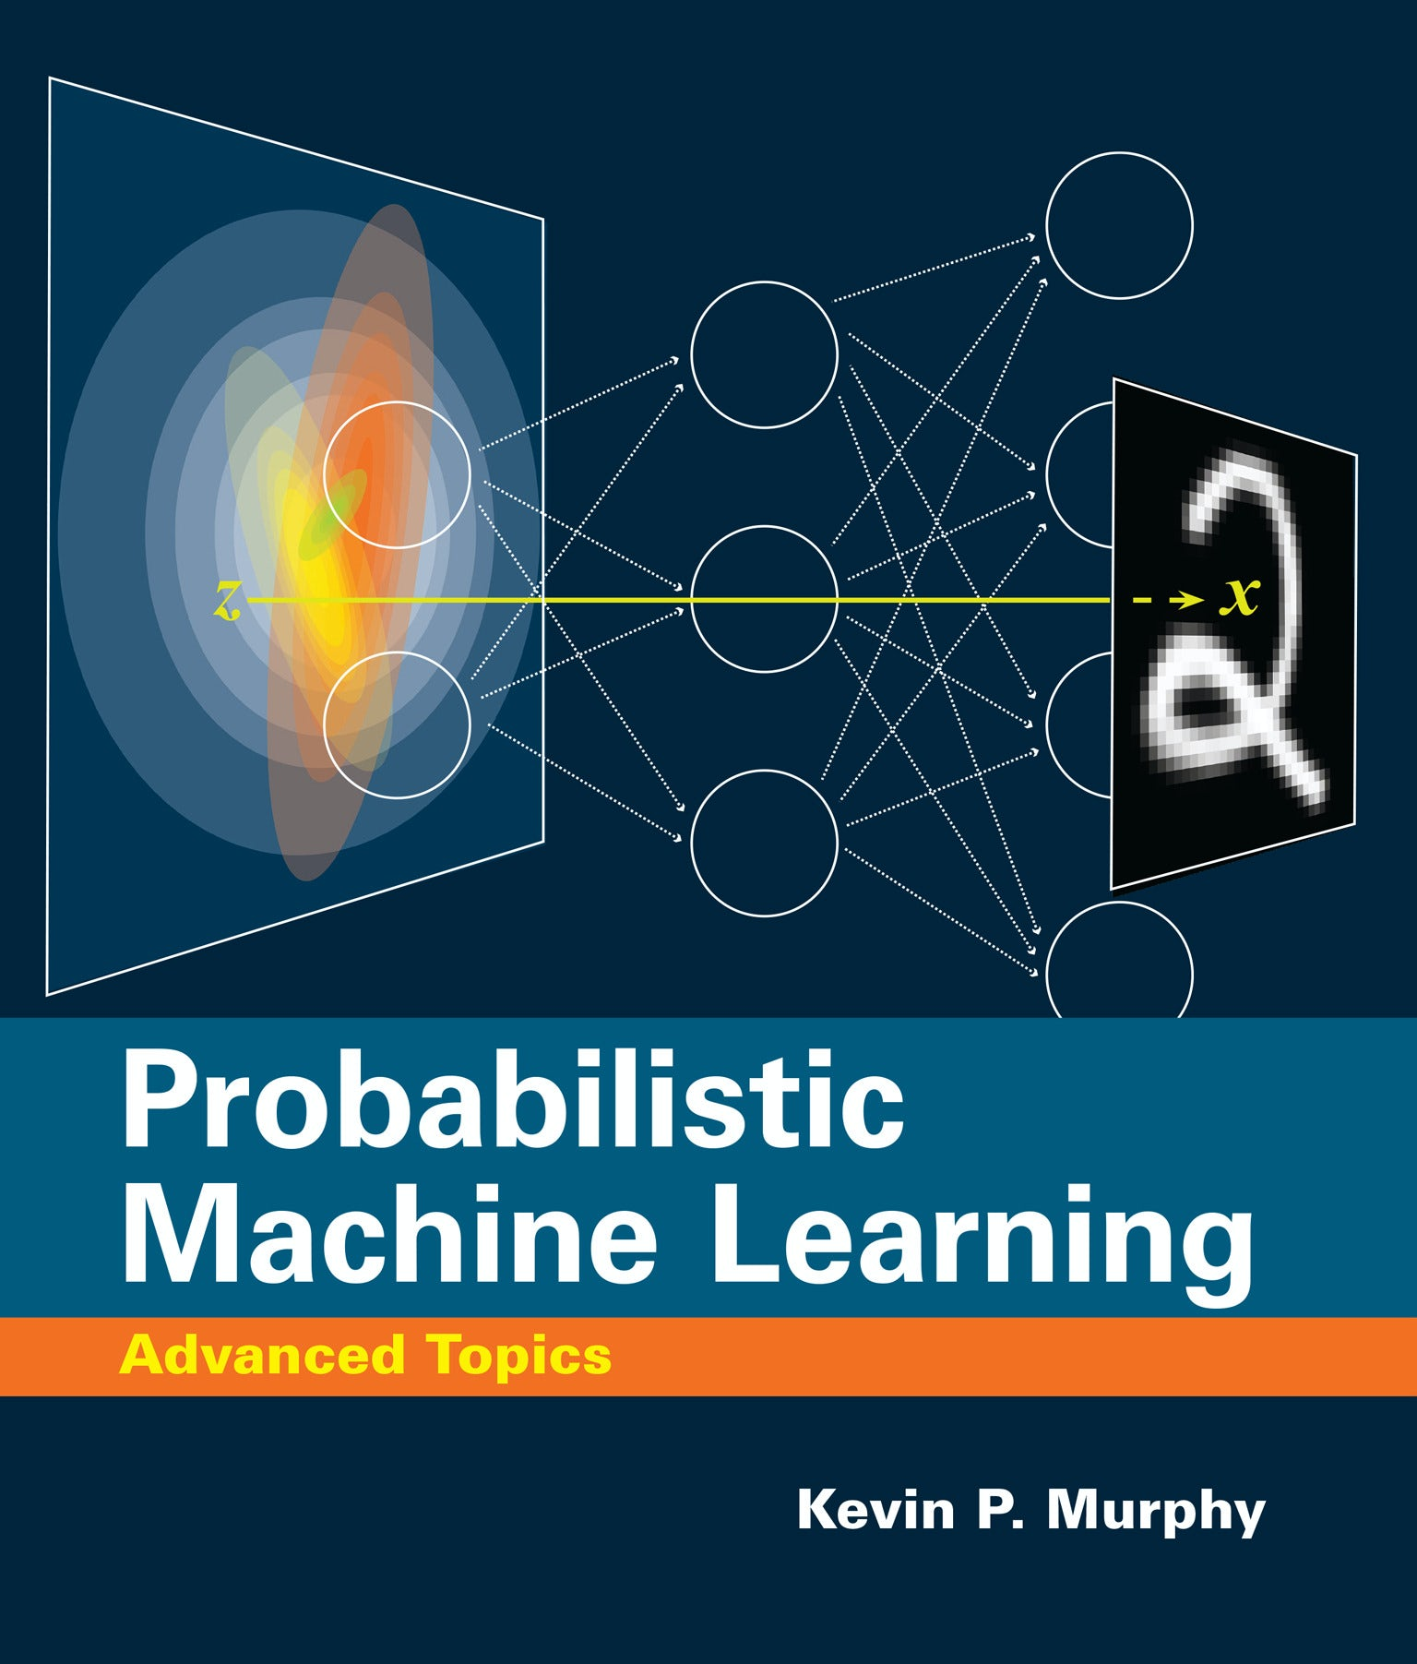
Probabilistic Machine Learning Advanced Topics By Kevin P. Murphy
Thigh-level textbook provides researchers and graduate students detailed coverage of cutting-edge topics in machine learning, including deep generative modeling, graphical models, Bayesian inference, reinforcement learning, and causality.
Covers generation of high dimensional outputs, such as images, text, and graphs
Discusses methods for discovering insights about data, based on latent variable models
Considers training and testing under different distributions
Explores how to use probabilistic models and inference for causal inference and decision making
Features online Python code accompaniment

Slide 20
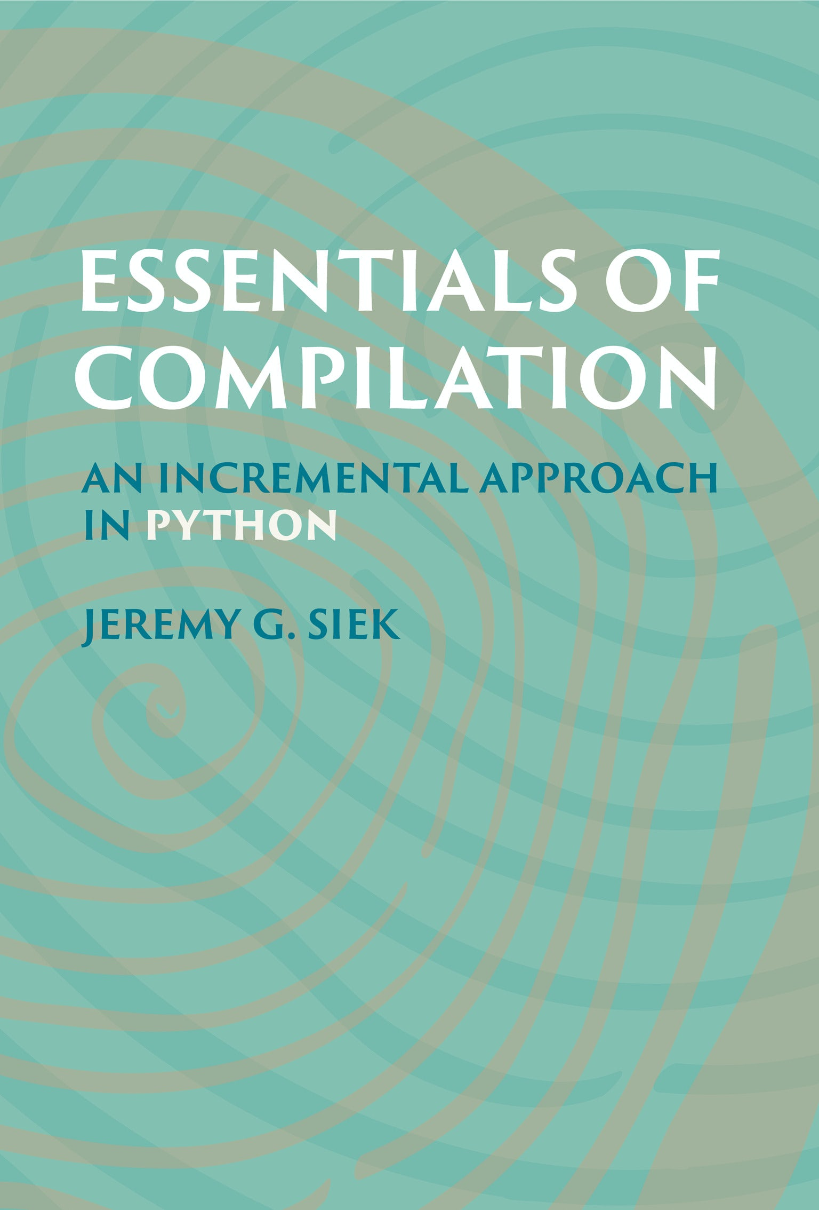
Essentials of Compilation An Incremental Approach in Python By Jeremy G. Siek
A hands-on approach to understanding and building compilers using the programming language Python.
Classroom-tested, suitable for students and professionals.
Extensive ancillary resources include source code and solutions.

Slide 21
Microeconomics of Banking Third Edition By Xavier Freixas and Jean-Charles Rochet
The third edition of a leading text on the microeconomic foundations of banking, comprehensively updated.
Up-to-date coverage of the latest research in banking theory as well as the events of the global financial crisis and resultant Basel III regulatory framework
New chapters on liquidity and systemic risk
New material throughout on cryptocurrencies, fintech, and other facets of a digitalized economy

Slide 22
Fairness and Machine Learning Limitations and Opportunities By Moritz Hardt, Solon Barocas, and Arvind Narayanan
An introduction to the intellectual foundations and practical utility of the recent work on fairness and machine learning.
Introduces the technical and normative foundations of fairness in automated decision-making
Covers the formal and computational methods for characterizing and addressing problems
Provides a critical assessment of their intellectual foundations and practical utility
Features rich pedagogy and extensive instructor resources

Slide 23
Mind Design III Philosophy, Psychology, and Artificial Intelligence Edited by John Haugeland, Carl F. Craver, and Colin Klein
The essential reader on the philosophical foundations and implications of artificial intelligence, now comprehensively updated for the twenty-first century.
Brand new introductions to each section that include suggestions for coursework and further reading.

Slide 24
The Foundations of Population Genetics By Daniel M. Weinreich
An accessible but rigorous treatment of the theoretical foundations of population genetics, featuring engaging real-world examples and extensive original figures.
Connects theory with the most recent genetic data better than existing texts
Features engaging real-world examples and extensive original figures
Provides dozens of carefully scaffolded questions that deepen the reader's understanding of key concepts
Ideal as a succinct reference for established scientists in biology, medicine, and computer science
Instructor resources available

Slide 25
Causal Analysis Impact Evaluation and Causal Machine Learning By Martin Huber
A comprehensive and cutting-edge introduction to quantitative methods of causal analysis, including new trends in machine learning.
Most complete and cutting-edge introduction to causal analysis, including causal machine learning
Clean presentation of rigorous material avoids extraneous detail and emphasizes conceptual analogies over statistical notation
Supplies a range of applications and practical examples using R

Slide 26
An Introduction to System Safety Engineering By Nancy G. Leveson
A comprehensive, up-to-date introduction to the foundations of classical safety engineering, with an emphasis on preparing for future challenges.
• Presents cutting-edge concepts anticipating the safety challenges of the future alongside thorough treatment of historical practices and ideas • Provides a comprehensive introduction to the foundations of safety engineering • Covers accident analysis, hazard analysis, design for safety, human factors, management, and operations • Incorporates extensive examples of real-world accidents and applications • Ideal for students new to safety engineering as well as professionals looking to keep pace with a rapidly changing field

Slide 27
Automata Theory An Algorithmic Approach By Javier Esparza and Michael Blondin
A comprehensive introduction to automata theory that uses the novel approach of viewing automata as data structures.
• Uses novel “automata as data structures” approach • Algorithm approach ideal for programmers looking to broaden their skill set and researchers in automata theory and formal verification • The first introduction to automata on infinite words that does not assume prior knowledge of finite automata • Suitable for both undergraduate and graduate students • Thorough, engaging presentation of concepts balances description, examples, and theoretical results • Extensive illustrations, exercises, and solutions deepen comprehension

Slide 28
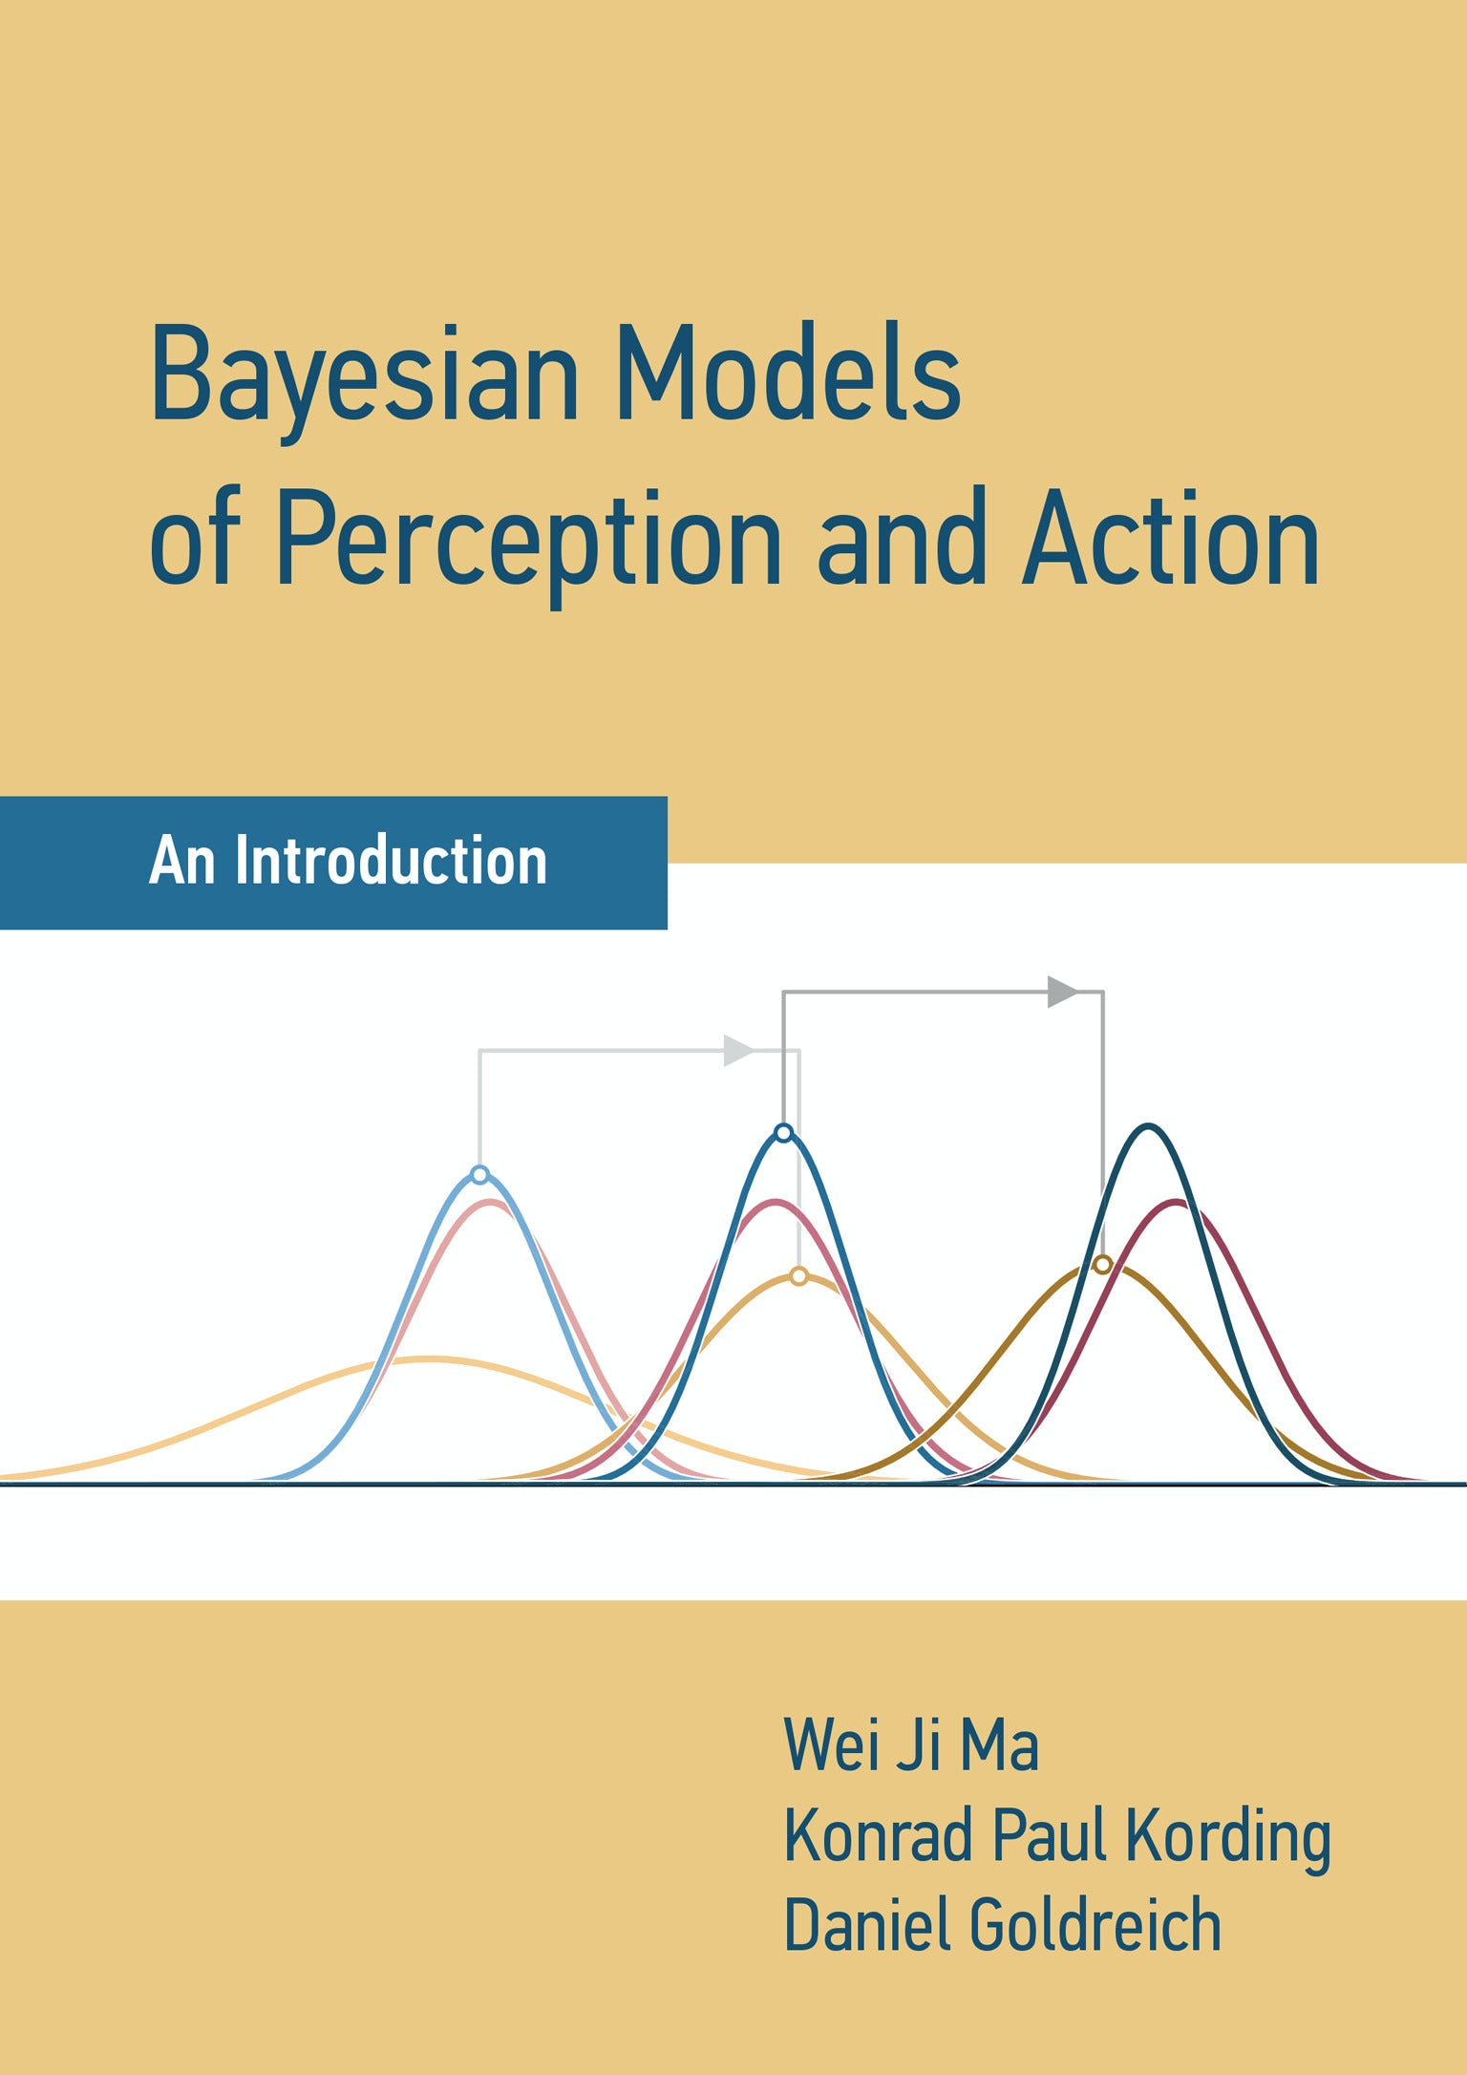
Bayesian Models of Perception and Action An Introduction By Wei Ji Ma, Konrad Paul Kording, and Daniel Goldreich
An accessible introduction to constructing and interpreting Bayesian models of perceptual decision-making and action.
• Introduces Bayesian models of perception and action, which are central to cognitive science and neuroscience • Beginner-friendly pedagogy includes intuitive examples, daily life illustrations, and gradual progression of complex concepts • Broad appeal for students across psychology, neuroscience, cognitive science, linguistics, and mathematics • Written by leaders in the field of computational approaches to mind and brain

Slide 29
Our Urban Future An Active Learning Guide to Sustainable Cities By Emily Talen and Sabina Shaikh
A practical, comprehensive textbook that uses active learning techniques to teach about the challenges and opportunities associated with urban sustainability.
• Approachable, discrete exercises introduce students to key sustainability subjects • Learn-by-doing approach encourages critically engaging from multiple angles • Ideal for students across environmental sustainability, urban planning, urban design, urban studies, sociology architecture, landscape architecture, and geography • Robust suite of ancillaries includes links and downloadable data to support activities, and additional readings and resources

Slide 30
Computability and Complexity By Hubie Chen
A clear, comprehensive, and rigorous introduction to the theory of computation.
Extensive exercises and diagrams enhance streamlined, student-friendly presentation of mathematically rigorous material
Includes thorough treatment of automata theory, computability theory, and complexity theory—including the P versus NP question and the theory of NP-completeness
Suitable for undergraduate and graduate students, researchers, and professionals

Slide 31
THE MIT PRESS Instagram: @mitpress Facebook: @mitpress Twitter: @mitpress Website: www.mitpress.mit.edu The Reader: www.thereader.mitpress.mit.edu
Pamela Quick
Subsidiary Rights Manager
The MIT Press
1 Broadway, 12th Floor
Cambridge, MA 02142 USA
quik@mit.edu

