Slide 1
The MIT Press Forthcoming Titles
Trade: pp. 2-9
Textbooks: p. 10
Pamela Quick, Subsidiary Rights Manager, The MIT Press, quik@mit.edu

Slide 2
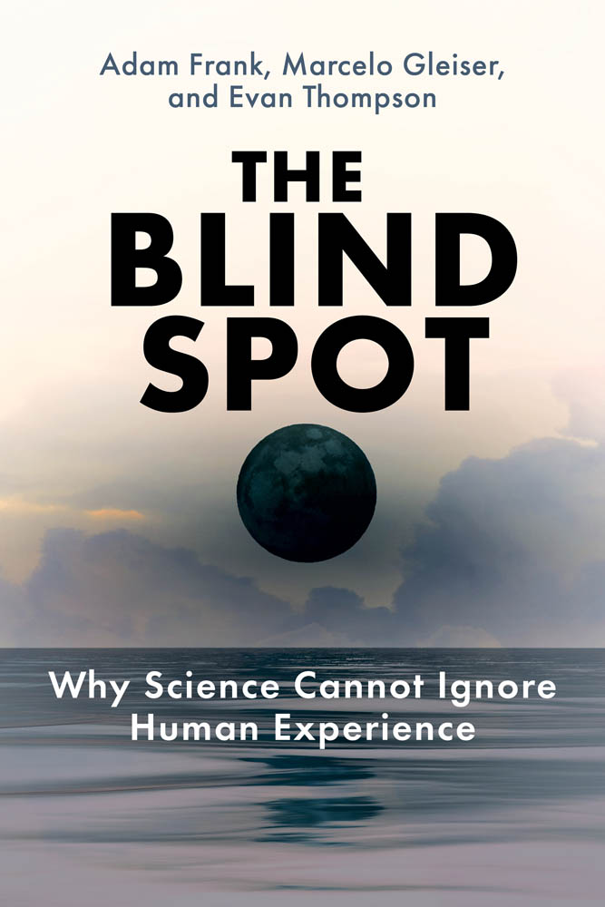
The Chinese Computer A Global History of the Information Age By Thomas S. Mullaney The fascinating, untold story of how the Chinese language overcame unparalleled challenges and revolutionized the world of computing. May 2024, 376 pp. [science, technology, and society] The Blind Spot Why Science Cannot Ignore Human Experience By Adam Frank, Marcelo Gleiser, and Evan Thompson A compelling argument for including the human perspective within science, and for how human experience makes science possible. March 2024, 328 pp. [cognitive science, philosophy]

Slide 3
Rebel Health A Field Guide to the Patient-Led Revolution in Medical Care By Susannah Fox An action-oriented and radically hopeful field guide to the underground, patient-led revolution for better health and health care. February 2024, 200 pp. [social science, health] The Secret Life of Data Navigating Hype and Uncertainty in the Age of Algorithmic Surveillance By Aram Sinnreich and Jesse Gilbert How data surveillance, digital forensics, and generative AI pose new long-term threats and opportunities—and how we can use them to make better decisions in the face of technological uncertainty April 2024, 304 pp. [information science]

Slide 4
Gaia’s Web How Digital Environmentalism Can Combat Climate Change, Restore Biodiversity, Cultivate Empathy, and Regenerate the Earth By Karen Bakker A riveting exploration of one of the most important dilemmas of our time: will digital technology accelerate environmental degradation, or could it play a role in ecological regeneration? April 2024, 280 pp. [environment] The Curie Society, Volume 2 Iris Eternal By Heather Einhorn, Adam Staffaroni, and Anne Toole. Illustrated by Sonia Liao. The plucky young scientist heroes of The Curie Society go toe-to-toe with a powerful and sinister threat in a globe-spanning scientific adventure on the cutting edge of advanced biotech. March 2024, 168 pp. [YA fiction, graphic novel]

Slide 5
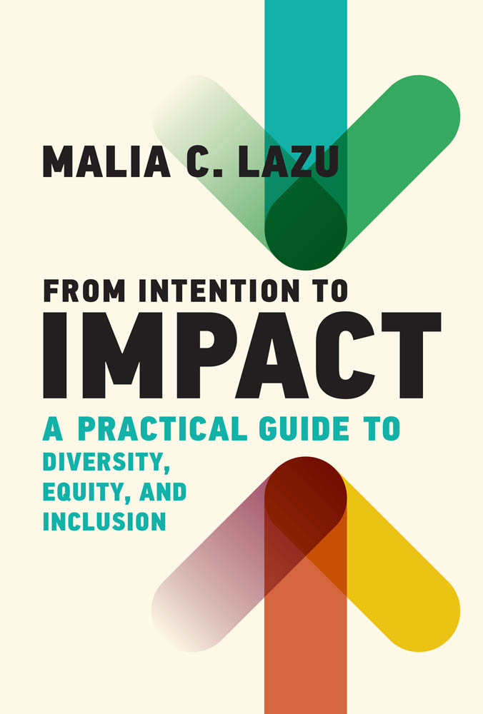
Counting Feminicide Data Feminism in Action By Catherine D’Ignazio Why grassroots data activists in Latin America count feminicide—and how this vital social justice work challenges mainstream data science. March 2024, 392 pp. [information science] From Intention to Impact A Practical Guide to Diversity, Equity, and Inclusion By Malia C. Lazu How business leaders can move their DEI efforts from intention to impact through strategy and culture change. February 2024, 192 pp. [management, business]

Slide 6
A Darwinian Survival Guide Hope for the Twenty-First Century By Daniel R. Brooks and Salvatore J. Agosta How humanity brought about the climate crisis by departing from its evolutionary trajectory 15,000 years ago—and how we can use evolutionary principles to save ourselves from the worst outcomes. February 2024, 360 pp. [science, nature] What’s That Smell? A Philosophy of the Olfactory By Simon Hajdini How our sense of smell engages with philosophy, psychoanalysis, and political economy—and how it can help enrich our understanding of the nature of truth, language, economy, and sexuality. March 2024, 216 pp. [philosophy, psychology]

Slide 7
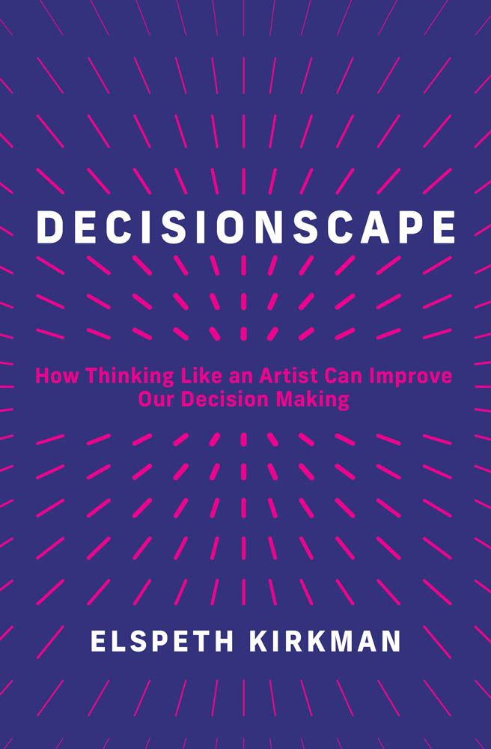
Mortevivum Photography and the Politics of the Visual By Kimberly Juanita Brown A powerful examination of the unsettling history of photography and its fraught relationship to global antiblackness. February 2024, 184 pp. [photography] Decisionscape How Thinking Like an Artist Can Improve Our Decision Making By Elspeth Kirkman How thinking like an artist can improve our decision making and provide the perspective necessary to make better choices. March 2024, 288 pp. [psychology, business]

Slide 8
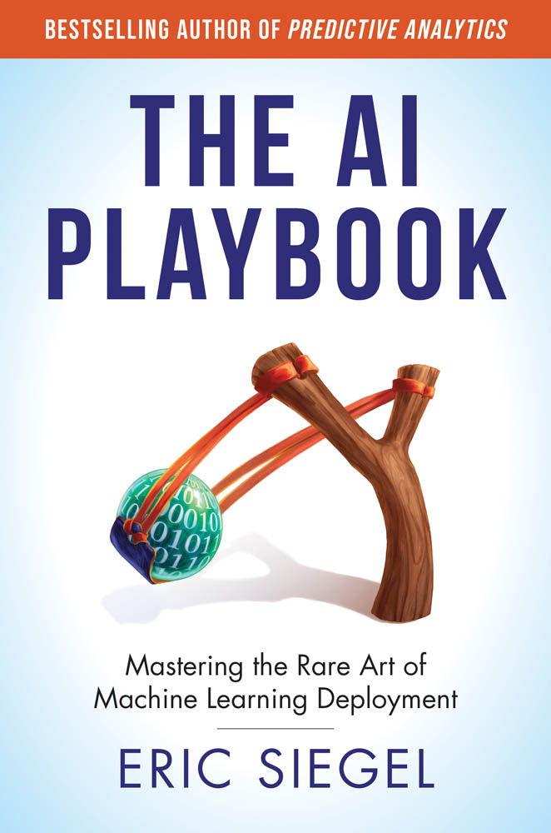
The Deep Language Revolution By Terrence J. Sejnowski This book tells the inside story of how large language models such as ChatGPT have captured the imagination of the world. The author describes how our future will be affected as we no longer are the only talking machines on the planet. September 2024, 250 pp. [computer science, artificial intelligence] The AI Playbook Mastering the Rare Art of Machine Learning Deployment By Eric Siegel In his bestselling first book, Eric Siegel explained how machine learning works. Now, in The AI Playbook, he shows how to capitalize on it. February 2024, 256 pp. [business, technology]

Slide 9
Tech Agnostic How Technology Became the World’s Most Powerful Religion By Greg M. Epstein A major humanist faith leader argues that technology has become the largest and most influential secular religion in history. To correct this, we need to become tech agnostics who refuse to accept this new theology on pure faith. September 2024, 280 pp. [technology and society] The Value of Values How Leaders Can Grow Their Businesses and Enhance Their Careers by Doing the Right Thing By Daniel Aronson Written by one of the world’s foremost experts on making ethical business count, this book trains leaders to respond smartly and credibly to today’s challenges, transforming how business can and should be done. February 2024, 312 pp. [management, business]

Slide 10
Foundations of Computer Vision By Antonio Torralba, Phillip Isola, and William T. Freeman An accessible, authoritative, and up-to-date computer vision textbook offering a comprehensive introduction to the foundations of the field that incorporates the latest deep learning advances. March 2024, 768 pp. [computer science textbook] Modeling Neural Circuits Made Simple with Python By Robert Rosenbaum An accessible undergraduate textbook in computational neuroscience that provides an introduction to the mathematical and computational modeling of neurons and networks of neurons. March 2024, 168 pp. [computational neuroscience textbook]

